Slide 1
Fermented foods
How microorganisms impact the taste and safety of food

Slide 2
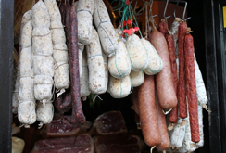
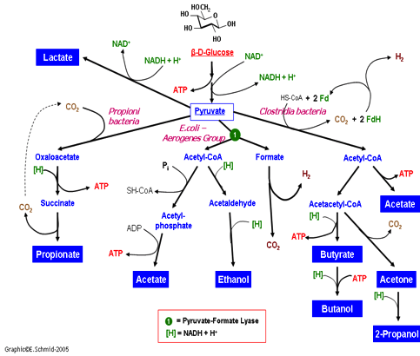
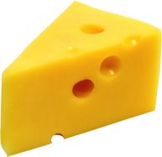
What are Fermented Foods?
Examples
What is it?
Notes:
Image URLs:
http://classroom.sdmesa.edu/eschmid/Lectur13.gif
http://www.automationheroes.com/wp-content/uploads/2013/11/tumblr_static_cheese_205_1362800142.jpg
http://mbioblog.asm.org/.a/6a0133ec8b9631970b017c3180a22b970b-pi
http://thumbs.dreamstime.com/x/kids-yogurt-pot-spoon-14751063.jpg
https://lygsbtd.files.wordpress.com/2011/08/beer_toast.jpg

Slide 3
Why Ferment Food?
Fermentation has been around since 8,000 B.C.
Safe foods, preservation, tasty
Notes:
How long have they been around. Why have humans used this processing technique?
Image URL: http://www.arabworldbooks.com/egyptomania/images/2.JPG

Slide 4
Food Microbiology
The Good
The Bad
And the Ugly
“One person’s fermented food is another person’s spoiled food”
BUT -- It’s okay to not like these foods, but it’s important to recognize that they have been dietary staples and are still widely consumed by MANY other people around the world.

Slide 5
What fermented foods can you think of?
Notes:
What fermented foods can you think of?

Slide 6
Aerobic Respiration:
Glycolysis → Krebs Cycle → Electron Transport Chain
Pyruvate
Glucose
NAD+
Pyruvate
NADH
NAD+
ATP
NADH
Fermentation:
Glycolysis → Various Fermentation Pathways
Glucose
NAD+
Pyruvate
Pyruvate
NAD+
Byproducts
Notes:
How do “good” fermentative organisms make foods safe, preserved, good to eat?
By products of the metabolic pathway

Slide 7
Breakout!
Measure the pH of fermented and fresh products
What is the pH of a cucumber: _____
What is the pH of a pickled (fermented) cucumber? ____
Notes:
Breakout! Measure acid in pickled food. Solid foods like pickles and cucumbers can be macerated with up to 20% their volume in additional water to get enough liquid to successfully measure the pH. It is also interesting to measure the pH of the pickling brine.
In this case, the acid produced by the fermentation of Lactic Acid Bacteria have preserved the food by lowering the pH. It should be noted that pickling sometimes just entails adding vinegar (acid) to the product, whereas in a fermented product the acid comes from the metabolism of the fermentative organism.

Slide 8
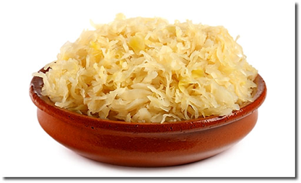
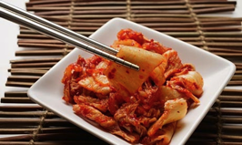
Regionally popular fermented foods
Kimchi
“Kim-chee”
Sauerkraut
Fermented sausages
Notes:
Many are culturally or regionally popular – they are important crops preserved for consumption in a given area. Could give examples of fermented foods that you, specifically eat (for me, pickled watermelon rinds). For instance, kimchi in Korea and sauerkraut in Germany. Historically, for many regions, people needed to make sure they could preserve a protein source. Some sausages are fermented. Although not fermented, some meat is dried for this purpose.
Image URLs: http://www.theguardian.com/lifeandstyle/2011/jan/23/kimchi-korea-rachel-cooke
http://www.mymenuntk.com.au/wp-content/uploads/2015/02/sauerkraut.jpg

Slide 9
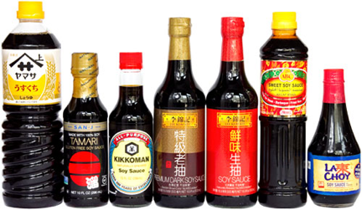
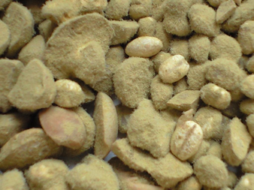
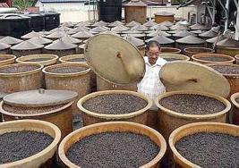
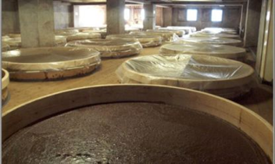
Soy Sauce
Mold (Aspergillus) coated soybeans
Notes:
In other areas of the world, soy is a major source of protein in the diet. Subsequently there are MANY examples of fermented soy products. This isn’t a dietary source of protein, but soy sauce is an example of a soy-based fermented food. In fact, the biggest brewery in the US makes soy sauce. Soy sauce is made from soybeans, salt, and wheat fermented by a mold (Aspergillus) and yeast (Saccharomyces)
Image URLs: http://www.seriouseats.com/images/20110328-soy-sauce-group.jpg
https://lh3.googleusercontent.com/-szq1a87F0AA/TWwlyjd0S-I/AAAAAAAAAUI/vryehF3WVBY/s1600/soy+sauce+fermentation+%2528Peter+Yew%2529.jpg
http://www.allaboutsushiguide.com/images/soy-sauce-fermenting-250.jpg
https://en.wikipedia.org/wiki/Soy_sauce#/media/File:Shoyukoji.jpg

Slide 10
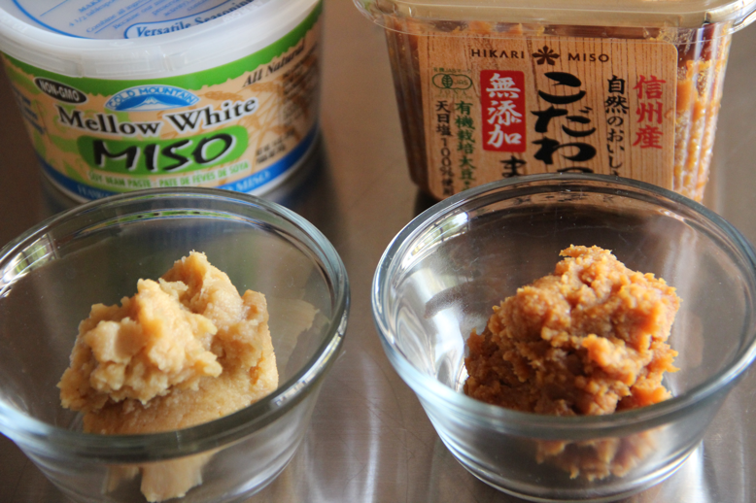
Miso
Notes:
Miso
Eaten as a condiment (in ramen noodles, for instance!)
Fermented by Aspergillus, again. The components are very similar to soy sauce (soy, roasted grain, salt, similar fermentative organisms)
Image URLs: http://www.japanesecooking101.com/wp-content/uploads/2012/02/IMG_6505.jpg

Slide 11
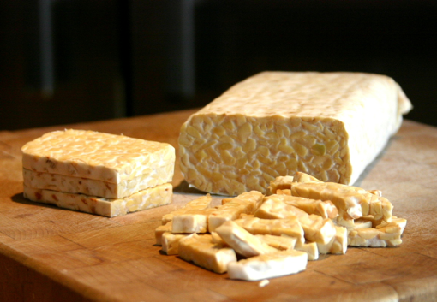
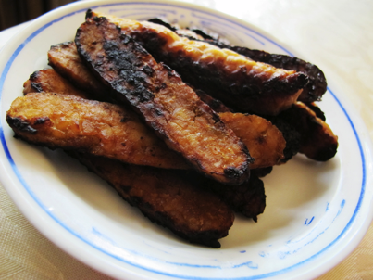
Tempeh
Raw tempeh, after fermentation
Fried tempeh, cut into strips
Notes:
Tempeh
Eaten as a meat substitute, could be fried or eaten raw. Similar to tofu in how it’s consumed.
Fermented by a mold (Rhizopus). Cooked soybeans are inoculated with the mold, which forms a solid mat around the beans. After fermentation, this cake can be sliced and prepared as you like.
Image URLs: https://en.wikipedia.org/wiki/Tempeh#/media/File:Sliced_tempeh.jpg
http://intentblog.com/wp-content/uploads/2012/08/tempeh_bacon.jpg

Slide 12
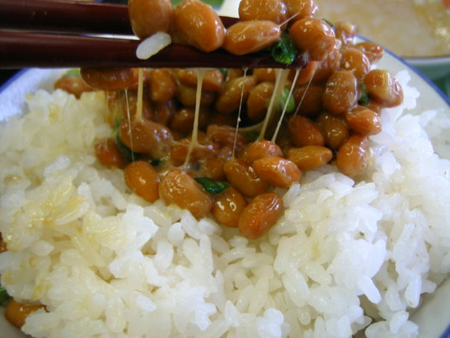
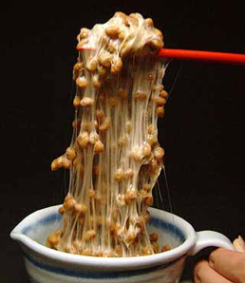
Natto
Notes:
Natto
Eaten as a kind of breakfast food, often with rice
Kind of bland and mushy, like the Japanese equivalent to oatmeal or grits.
Fermented by a bacterium (Bacillus)
http://static1.squarespace.com/static/54e0ac47e4b0541797890fbd/54f65affe4b034a7acc838a3/54f65b00e4b095ecd49f6f9e/1425431297547/natto-1.jpg?format=500w
https://upload.wikimedia.org/wikipedia/commons/b/b3/Natto_on_rice.jpg

Slide 13
How to make natto
https://www.youtube.com/watch?v=G-xPnseiPXQ
Notes:
Tomorrow you are making natto – watch video
How to make the easiest natto(Method to use the Natto bacteria)

Slide 14
Start the pre-soak!
Break up into groups
Each group should measure out 1 cup of soybeans
Add warm water to cover the beans
Notes:
Have each group soak 1 cup of beans

