Slide 1
Effects of Browning
and
High Oleic Oil

Slide 2
Browning and Sensory Characteristics

Slide 3
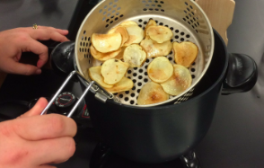
Browning
Occurs when a product is exposed to oxygen
Types of browning : Maillard Reaction, Caramelization, Enzymatic Browning

Slide 4
Science behind Potato Chip frying
Dehydration occurs as the chip cooks
Oil enters the plant cells allowing water to escape
Natural sugars in the potato begin to brown and caramelize making the chip darker
Reducing Sugar + Amine Group ➔ Browning + Flavor

Slide 5
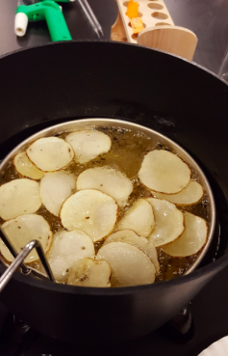
Browning in Potato Chips
Sometimes a darker potato chip is desirable
At times a lighter golden color is desirable
Color can be manipulated by treating potato chips before frying begins

Slide 6
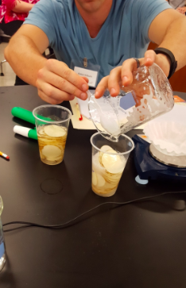
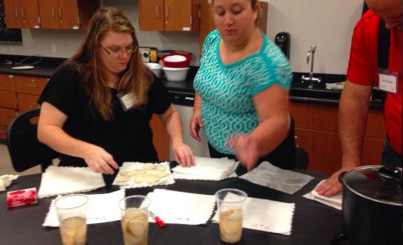
Soaking Solutions
Water (Control)
Water + Sugar
Water + Alt. Sugar Source
Water + Amino Acid
Water + Acid Solution
(prevent sugars/brown)

Slide 7
Browning: Sensory Science
Desirable Browning | Undesirable Browning
Coffee | Apples
Tea | Avocado
Dried Fruit | Banana
Can you think of other examples?

Slide 8
Which is the perfect potato chip?
Conventional Commodity Soybean Oil
 | Control | Solution 1: Sucrose | Solution 2: Sucrose + Amino Acid | Solution 3: Alt. Sugar
Appearance
Texture
Smell
Flavor
Overall Preference

Slide 9
Which is the perfect potato chip?
Plenish™ High Oleic Soybean Oil
 | Control | Solution 1: Sucrose | Solution 2: Sucrose + Amino Acid | Solution 3: Alt. Sugar
Appearance
Texture
Smell
Flavor
Overall Preference

Slide 10
High Oleic Oil

Slide 11
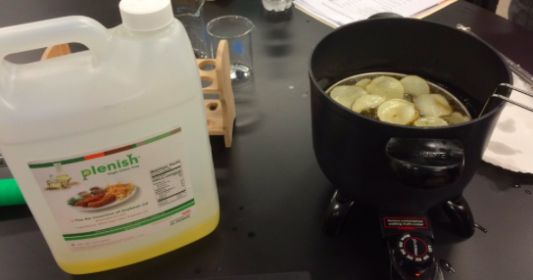
High Oleic Soybean Oil
High oleic oil from soybeans is a modification to traditional soybean oil that has an increased level of monounsaturated fatty acid. This oil has more desirable chemical and physical properties than conventional soybean oil.

Slide 12
Advantages of High Oleic Soybean Oil
Neutral flavor
Highest heat stability
Zero grams of trans fat
Cost effective
Notes:
All from uintedsoybean

Slide 13
Rancidity

Slide 14
Rancidity
Overtime the lipids in potato chips begin to oxidize
As a result there is an undesirable flavor or smell
Light can increase the rate of oxidation
The rate of lipid oxidation decreases when using high oleic oils

Slide 15
Rancidity test
After frying potato chips in each oil: commodity (vegetable) and high oleic oil:
Place samples of potato chips in clear plastic bags and expose them to natural light.
After a few days, open the package and note the overall appearance, smell and feel of each chip.

Slide 16
Thanks, DuPont Pioneer!

