Slide 1
Oh Soy Good!
Data Collection Log Book
Name:
Notes:
Pictures from United Soybean Board flickr account

Slide 2
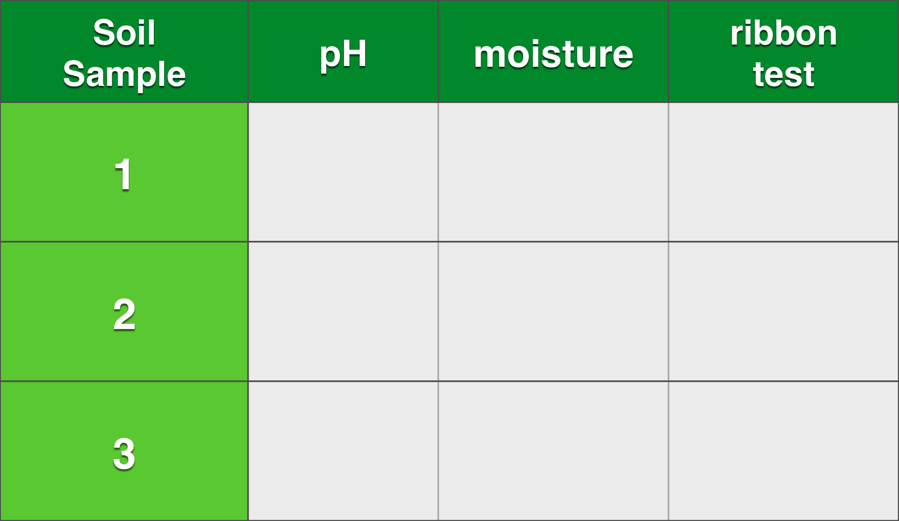
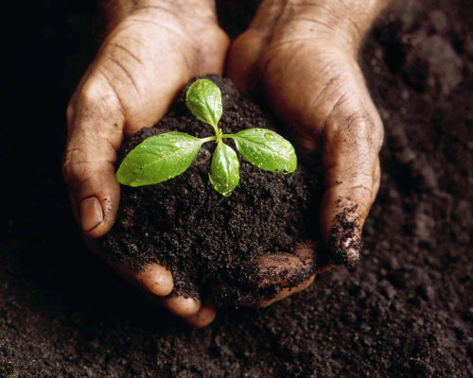
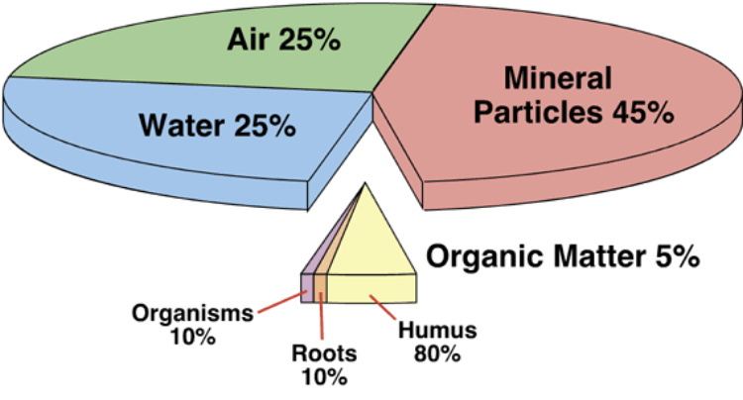
Soil Tests

Slide 3
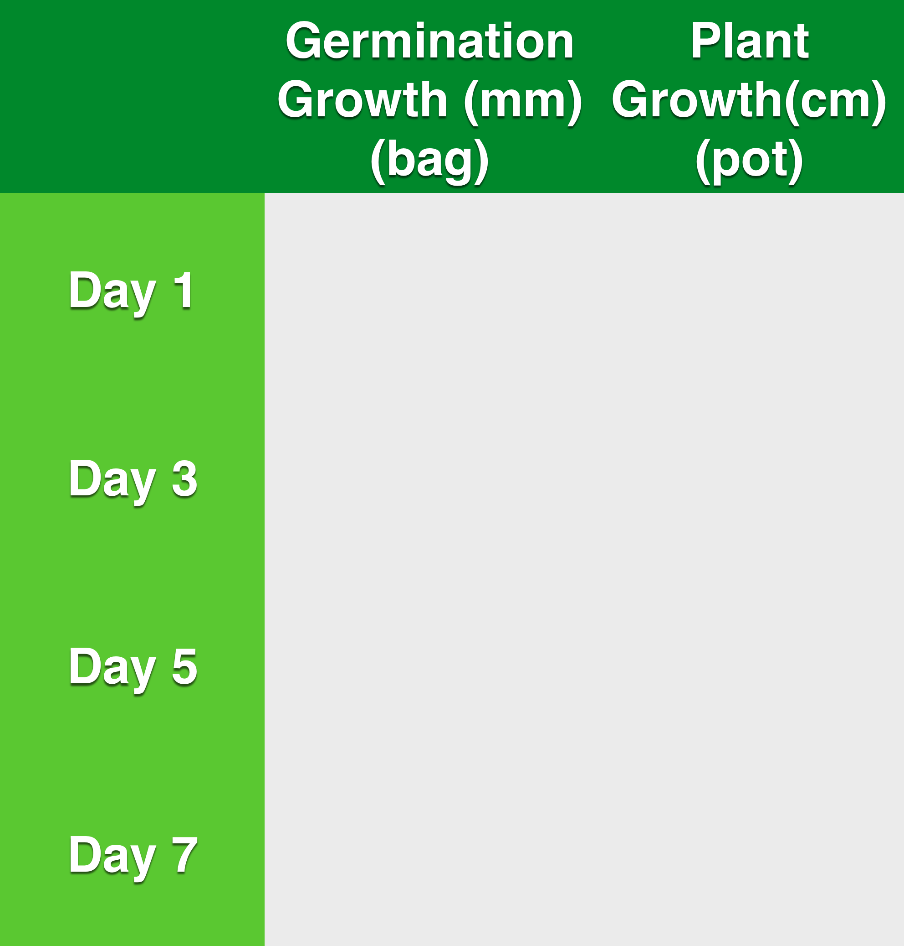
Soybean Growth
Continue until flowers appear(R2)

Slide 4
Soybean Growth Graph
Growth
(cm)
Day #

Slide 5
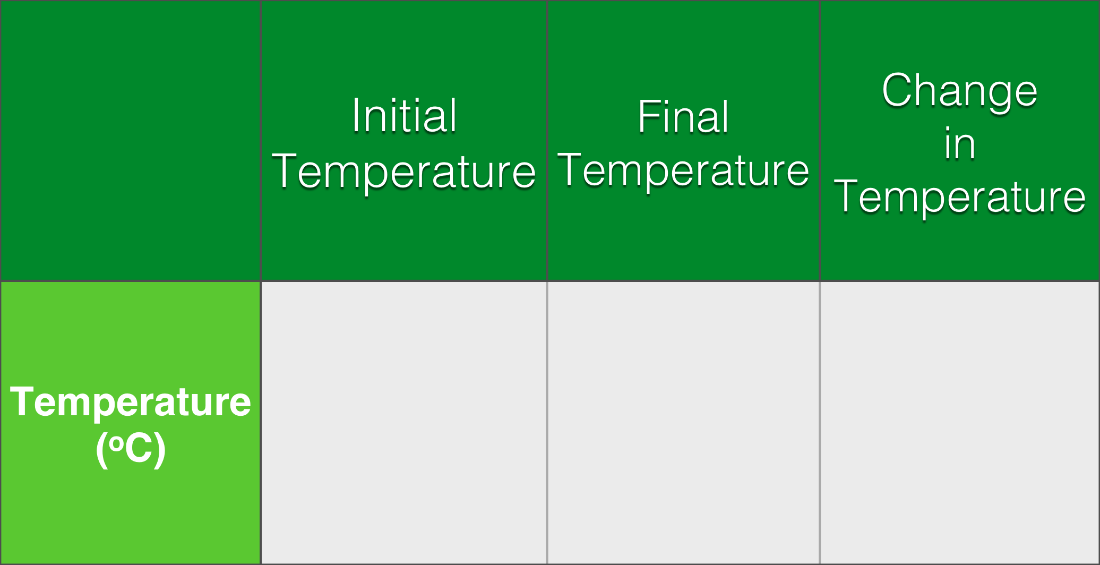
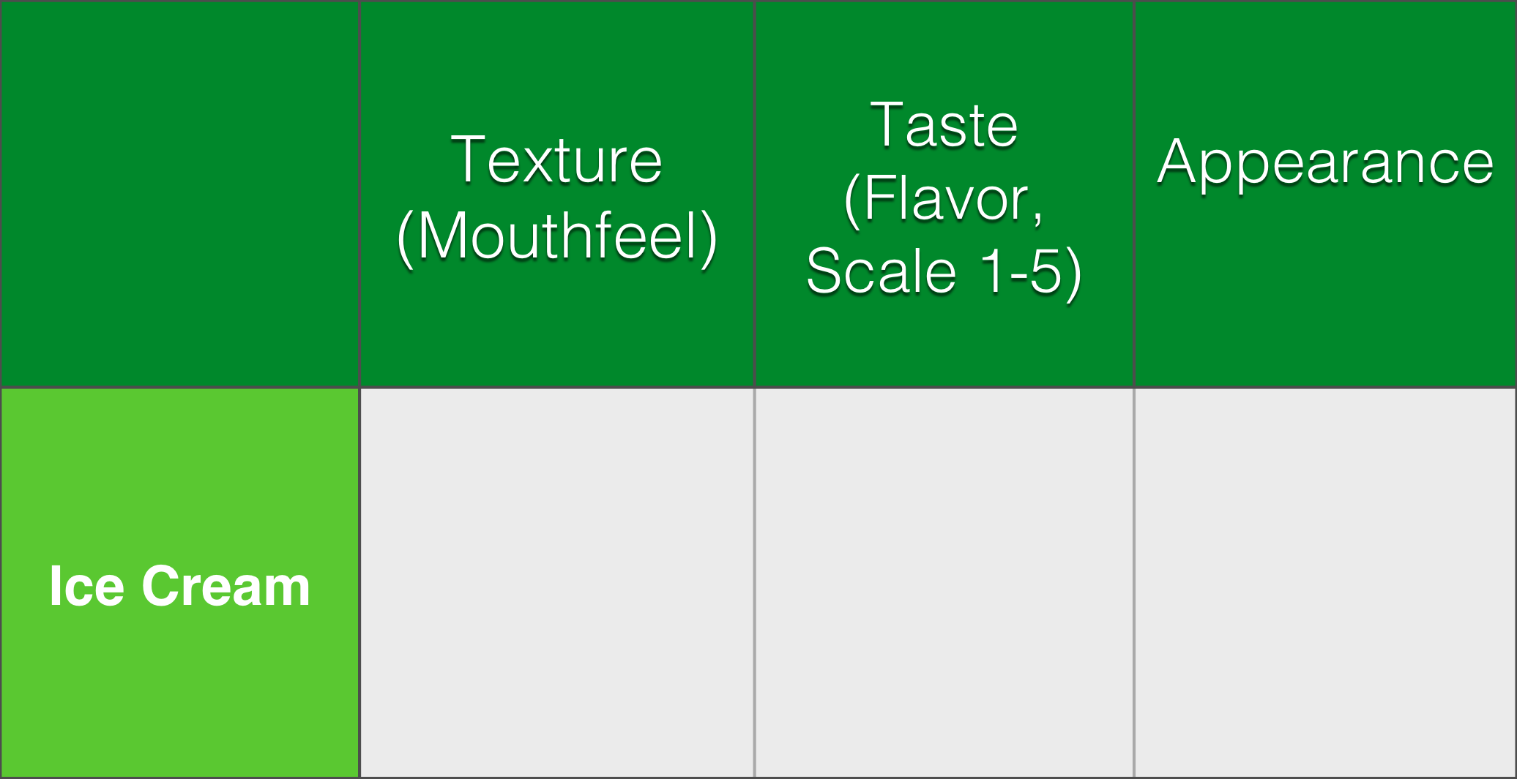
Temperature Change & Taste Test

