Slide 1
Oh Soy Good!
Data Collection Log Book
Name:
Notes:
Pictures from United Soybean Board flickr account

Slide 2
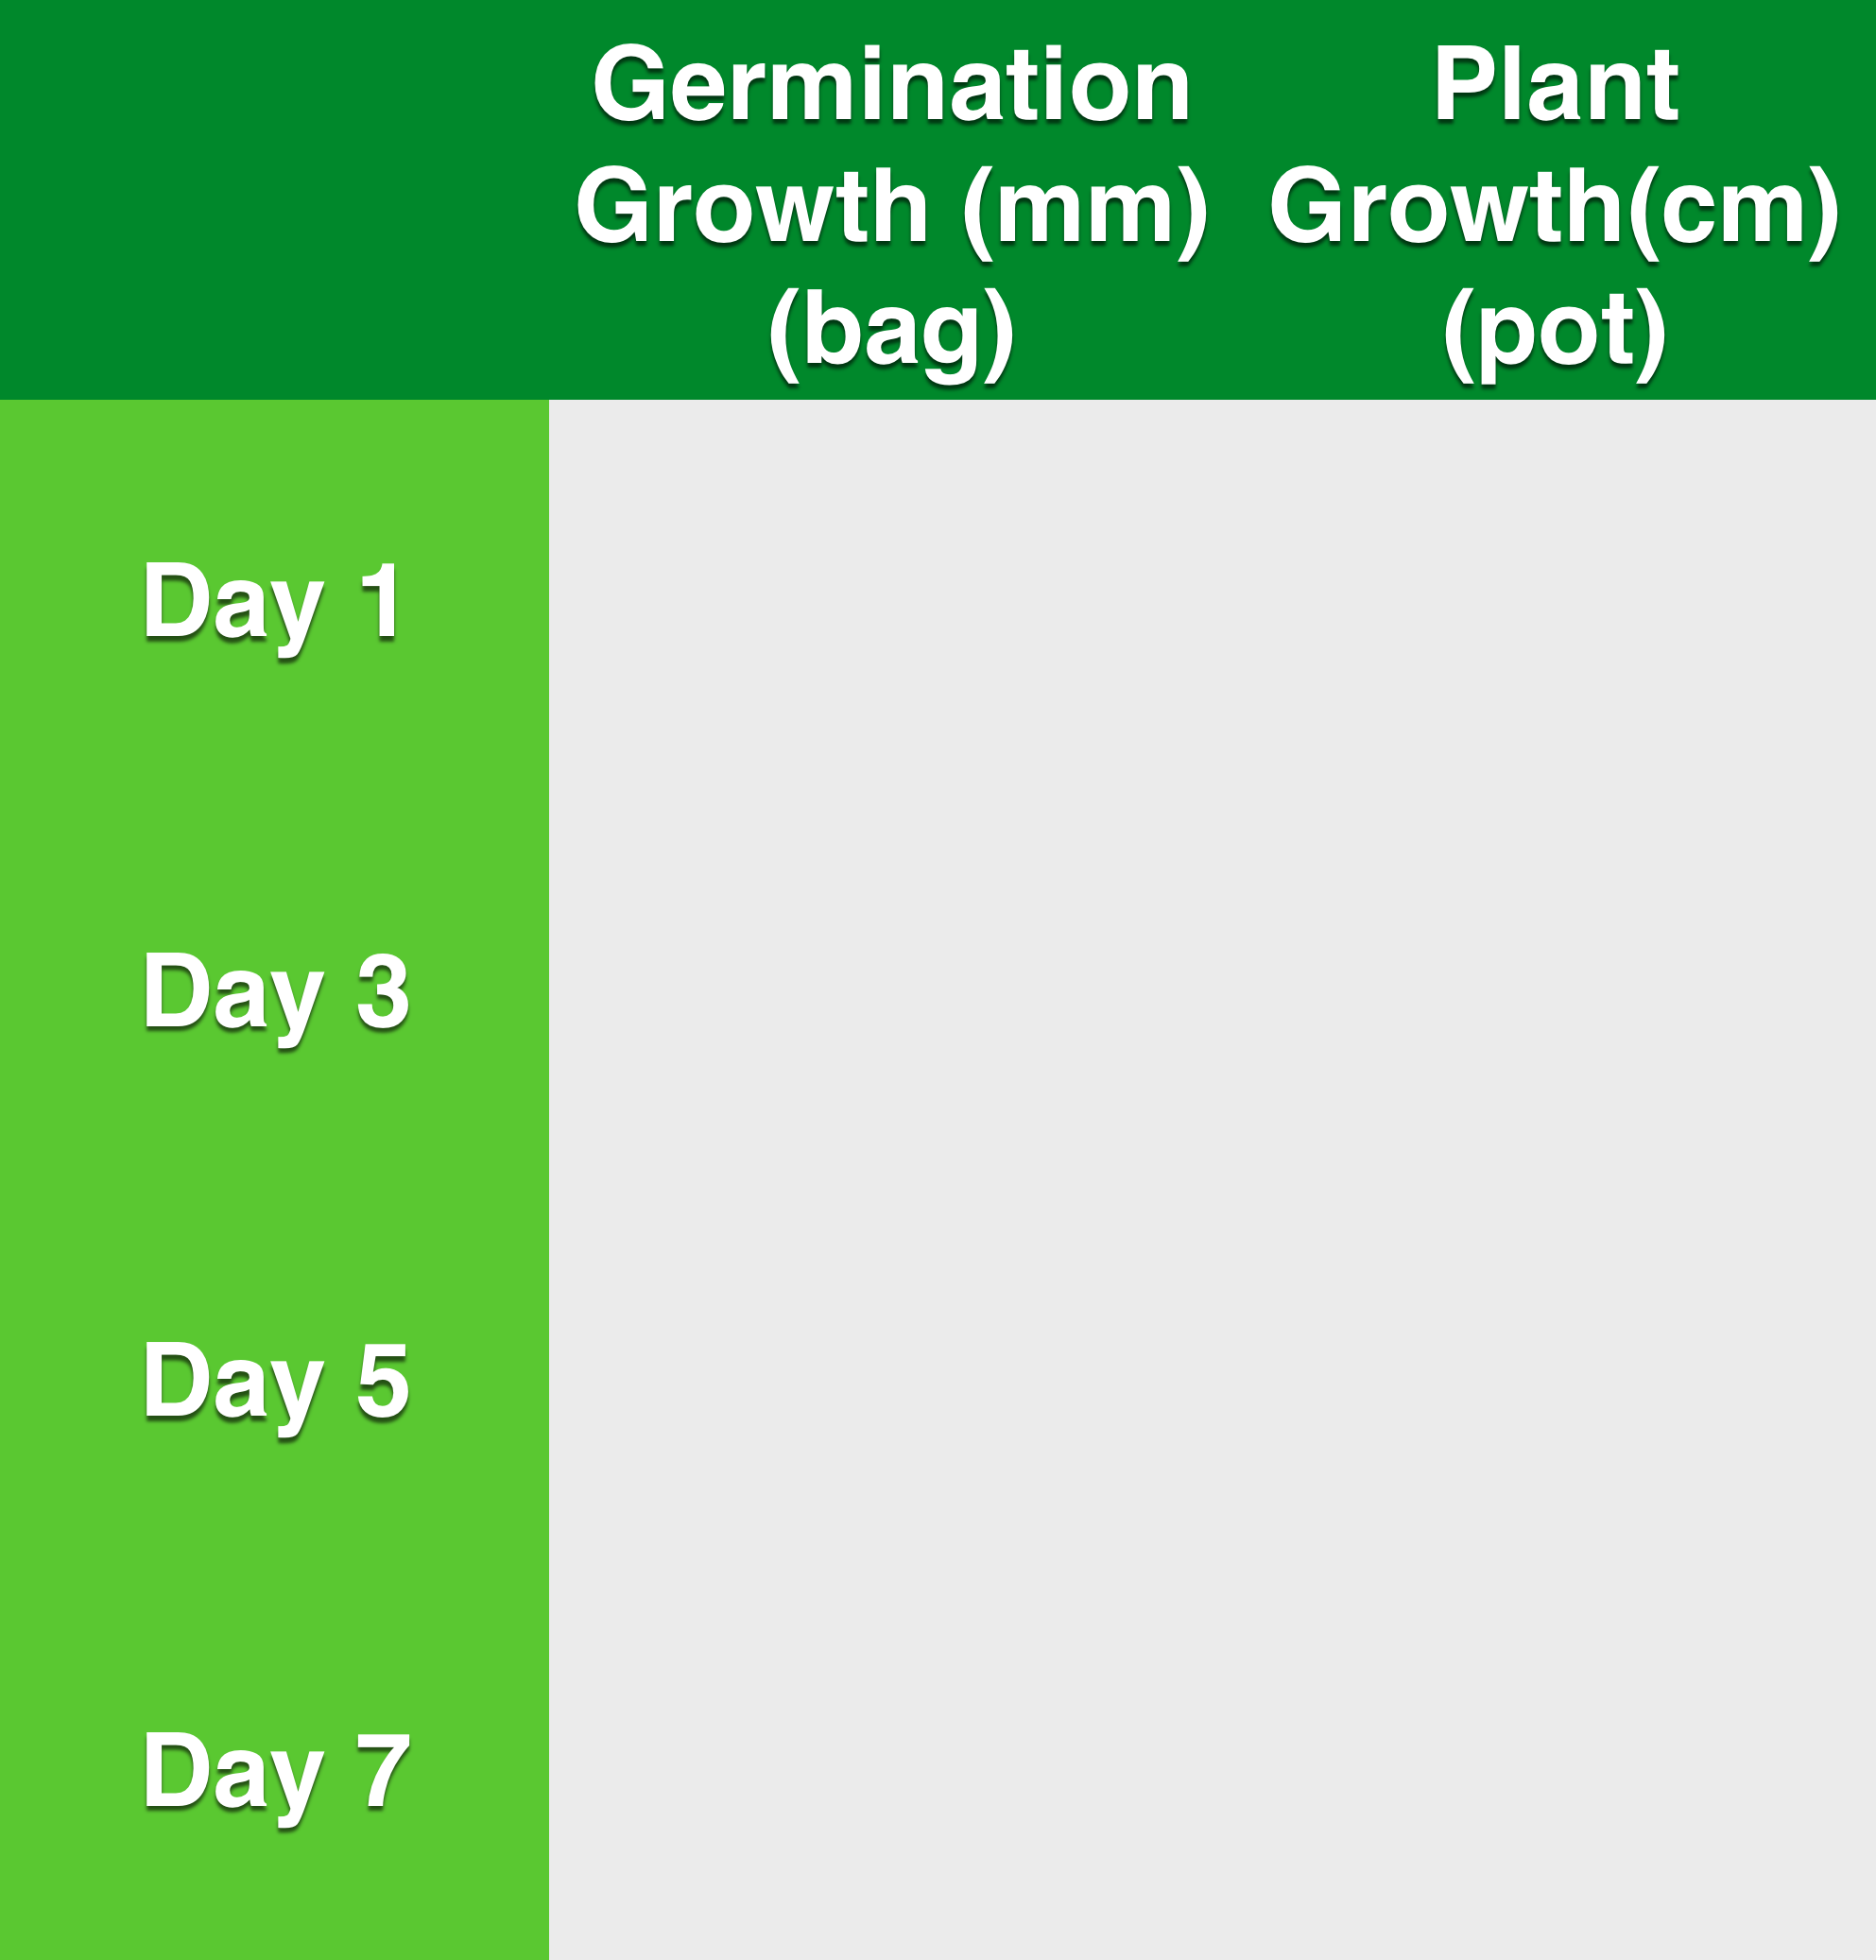
Soybean Growth
Continue until flowers appear(R2)

Slide 3
Soybean Growth Graph
Growth
(cm)
Day #

Slide 4
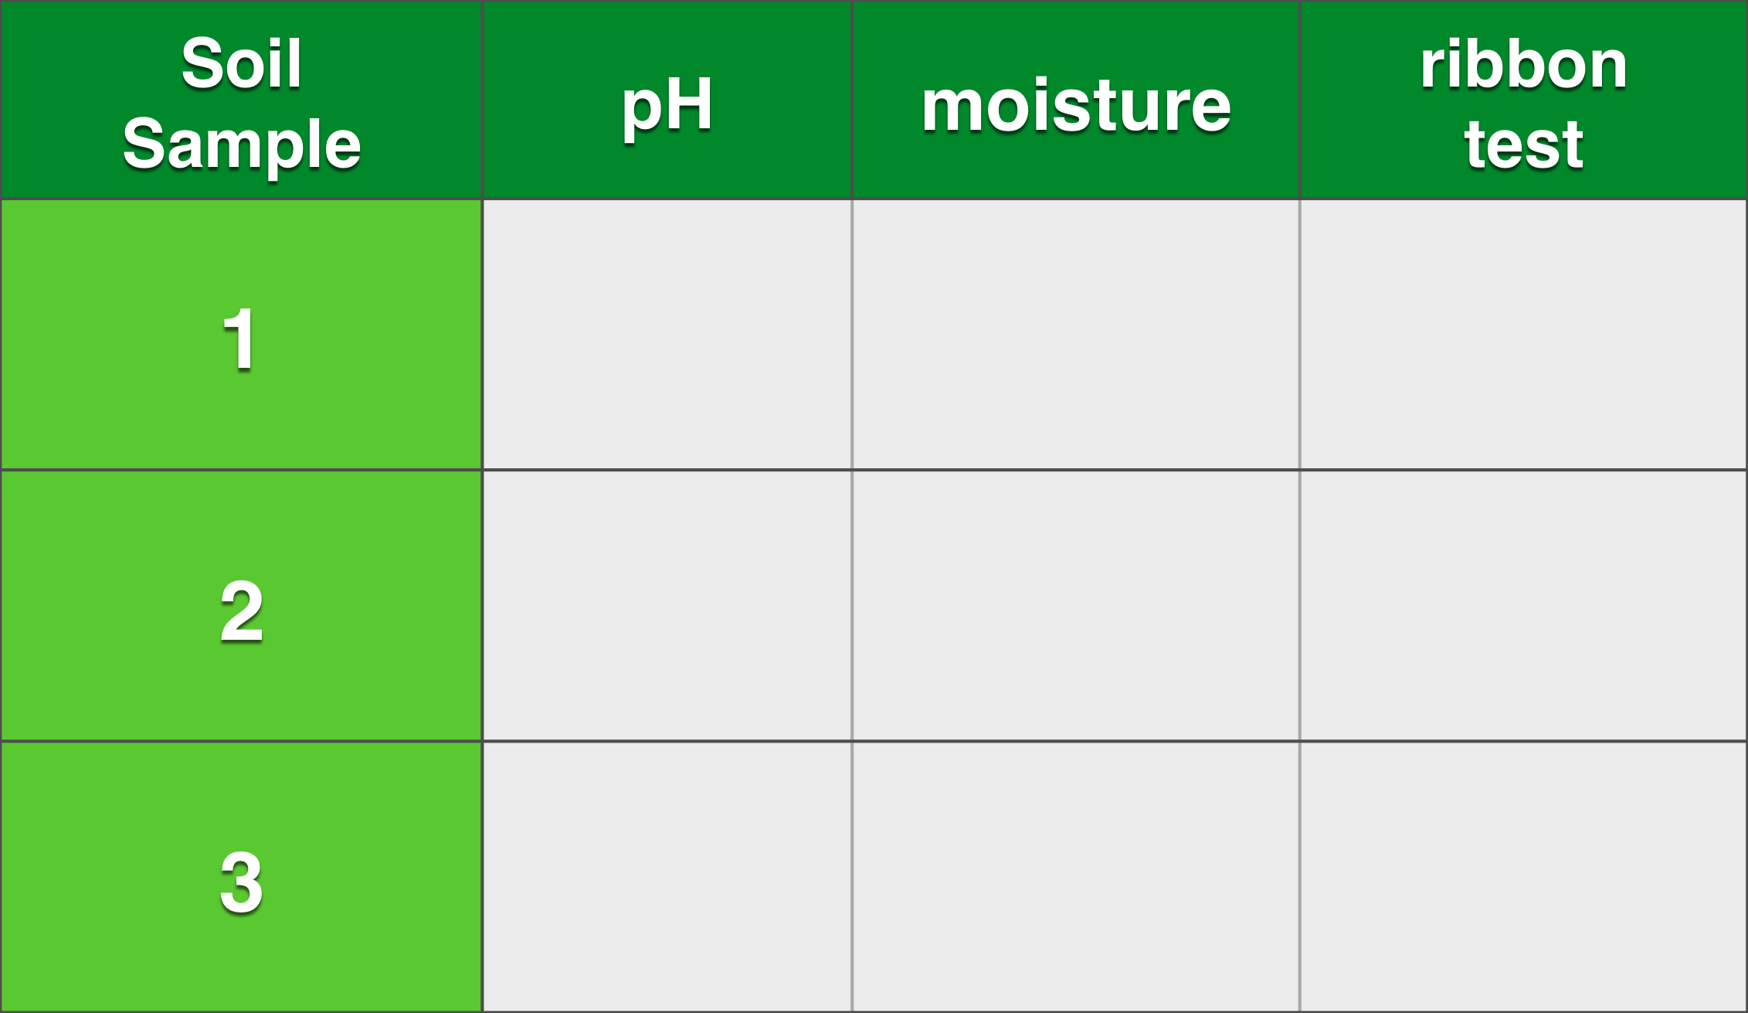
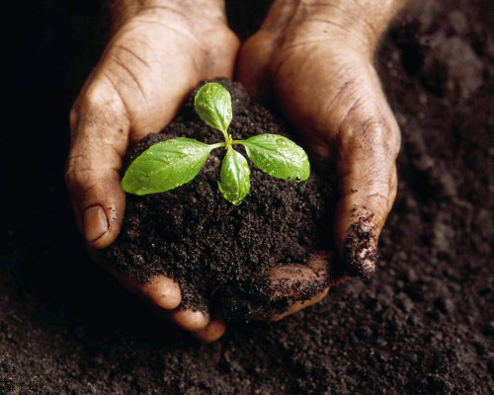
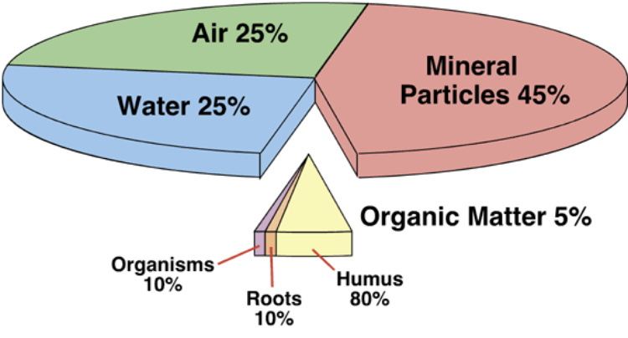
Soil Tests

Slide 5
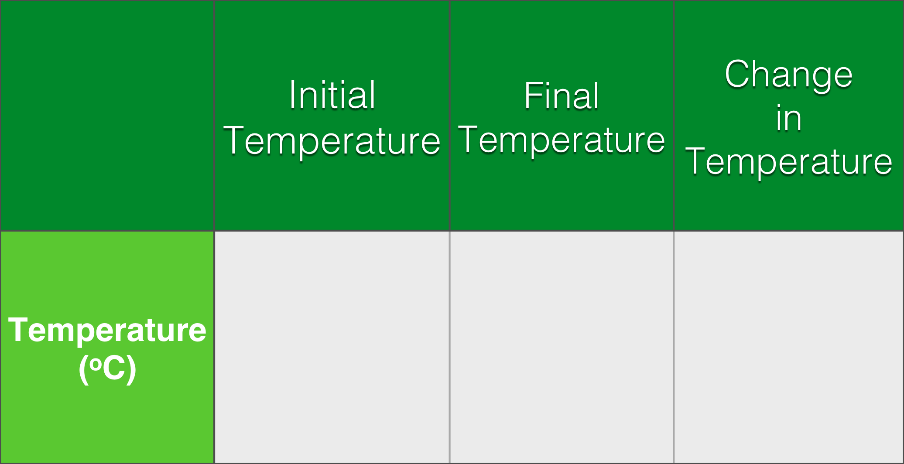
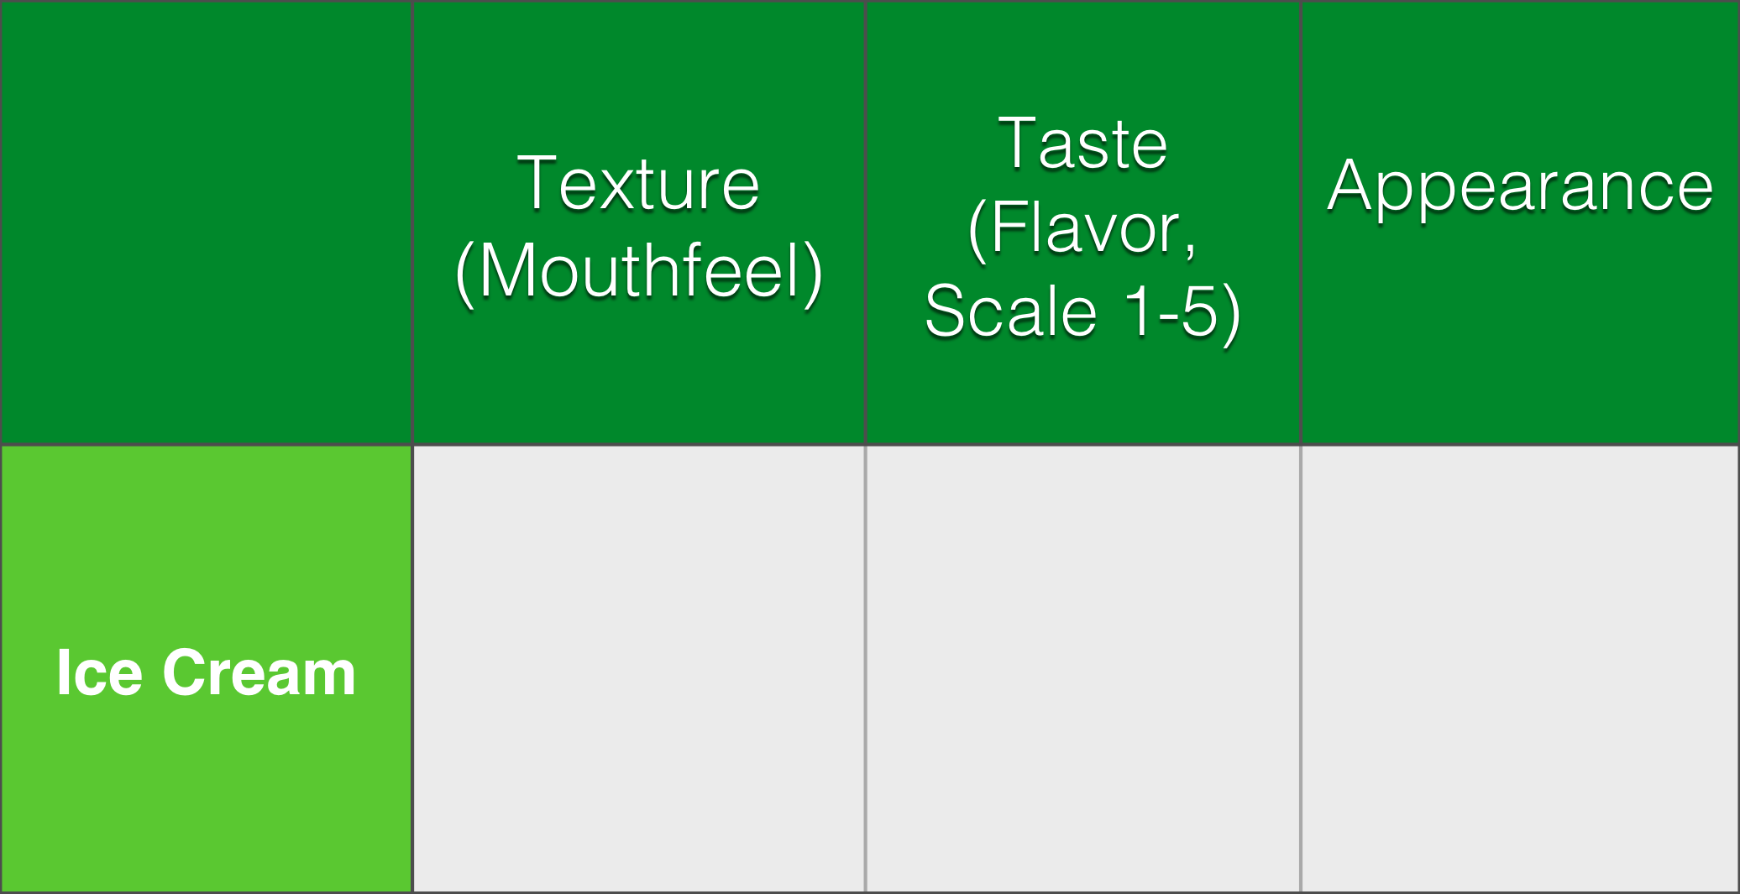
Temperature Change & Taste Test

Slide 6
Calculating Theoretical Freezing Point Depression
Calculations:
 | NaCl | H₂O
Mass (g)
Molar Mass
Moles
kg

