Slide 1
Oh Soy Good!!

Slide 2
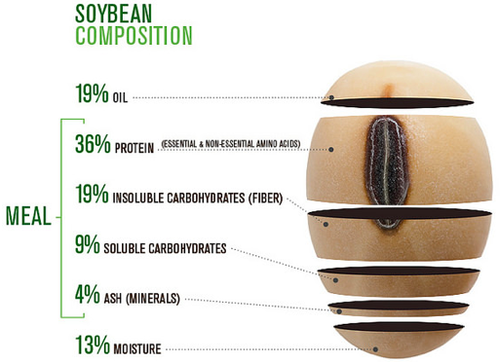
What is in a Soybean?
United Soybean Board
United Soybean Board
Soybeans - Soil oil (Fats/Lipids) = Soy meal (Protein)
Notes:
https://www.flickr.com/photos/unitedsoybean/16153987938/
https://www.flickr.com/photos/unitedsoybean/10059732523/in/album-72157636129600256/

Slide 3
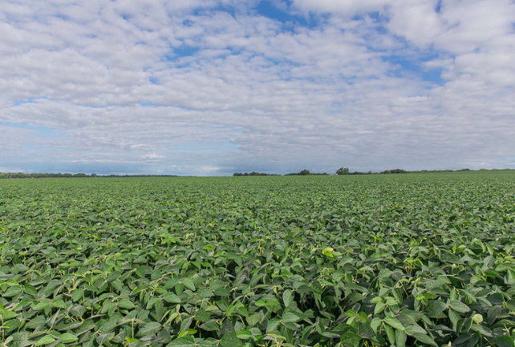
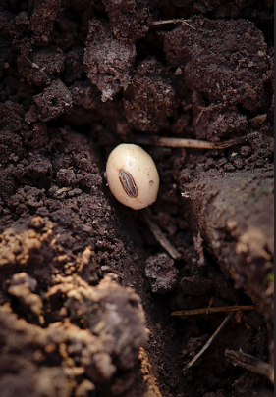
Plants need nutrients to:
Flower
Produce seeds
Produce fruit
Plants need:
Sunlight
Soil
Water
Key nutrients are often added with fertilizers (N, P, K)
United Soybean Board
United Soybean Board
Notes:
https://www.flickr.com/photos/unitedsoybean/9632914516/in/album-72157635300073573/
https://www.flickr.com/photos/unitedsoybean/9623515112/in/album-72157635288860020/

Slide 4
Photosynthesis
Plants are producers, they utilize sunlight and surrounding compounds to make glucose (sugar) that is used for energy.
CO₂ + H₂0 Sunlight C₆H₁₂O₆ + O₂
Carbon + Water Sugar + Oxygen
_{Dioxide}
Notes:
http://newsouthbooks.com/alagroecosystem/supplement/images.php?uuid=f49

Slide 5
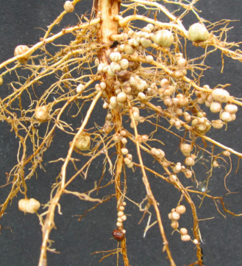
Nitrogen
Plants receive Nitrogen from soil, Nitrogen-fixing bacteria found in the nodules on the roots of some plants, and fertilizers.
Nitrogen allows plants to grow tall and healthy
Nitrogen is necessary for chlorophyll (the pigment that makes plants green)
7
N
Nitrogen
14.00674
United Soybean Board
Notes:
http://www.robbinsfarmgarden.org/category/about/soybeans

Slide 6
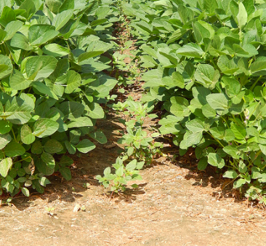
Phosphorus
Plants receive Phosphorus from the soil and fertilizers.
Helps plants grow tall and develop roots, flowers and seeds
Phosphorus assists with respiration
Plants need Phosphorous to reproduce
15
P
Phosphorus
30.983761
United Soybean Board
Notes:
https://www.flickr.com/photos/unitedsoybean/9623983570/in/album-72157635282760631/

Slide 7
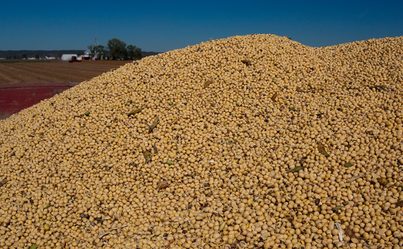
Potassium
Plants receive Potassium from soil and fertilizers
Contributes to disease protection
Aids in water control
Increases leaf production
19
K
Potassium
39.0983
United Soybean Board
Notes:
https://www.flickr.com/photos/unitedsoybean/10138334204/in/album-72157636940843454/

Slide 8
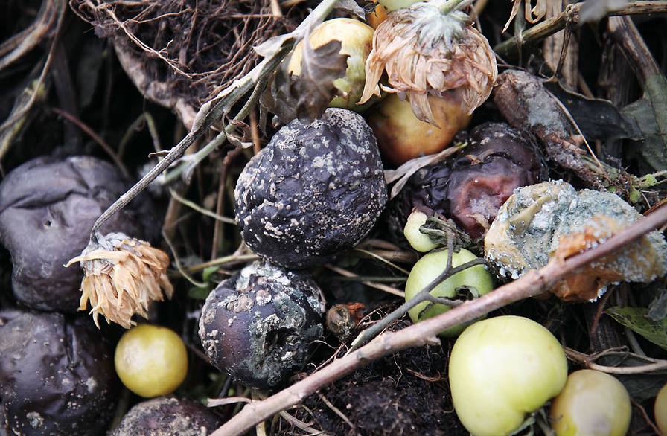
Carbon
Soybeans receive Carbon Dioxide (CO₂) from the air and organic matter.
CO₂ is necessary to make sugar (C₆H₁₂O₆) during photosynthesis
Decomposing materials such as manure, saw dust and plant debris provide Carbon
6
C
Carbon
12.0107
United Soybean Board
Notes:
http://res.freestockphotos.biz/pictures/9/9139-rotten-fruit-on-compost-pv.jpg

Slide 9
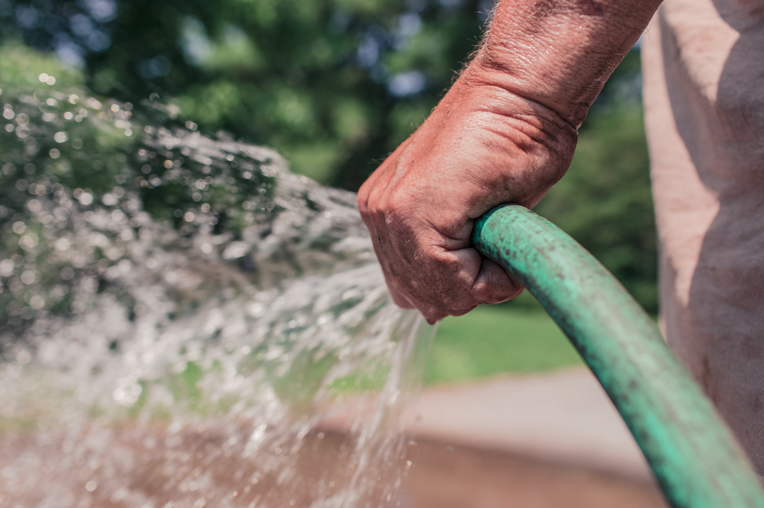
H₂O Water
Plants receive Hydrogen and Oxygen from water (H₂O)
Water is needed for photosynthesis to begin
Soil moisture (water in soil) determines the kind of plants that can grow.
H O H
Water
Notes:
https://static.pexels.com/photos/2259/man-hand-garden-growth.jpg

Slide 10
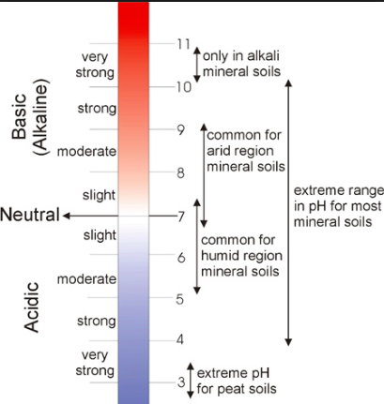
For optimum growth, Soil should have a pH range of 6.0-7.0.
pH is important for high yielding and profitable soybeans
A pH of 6.3-6.5 is ideal for maximum Nitrogen fixation and nutrient availability
Wiki.CA
Notes:
http://wiki.ubc.ca/LFS:SoilWeb/Interactions_Among_Soil_Components/Soil_Acidity

Slide 11
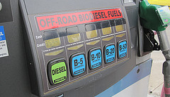
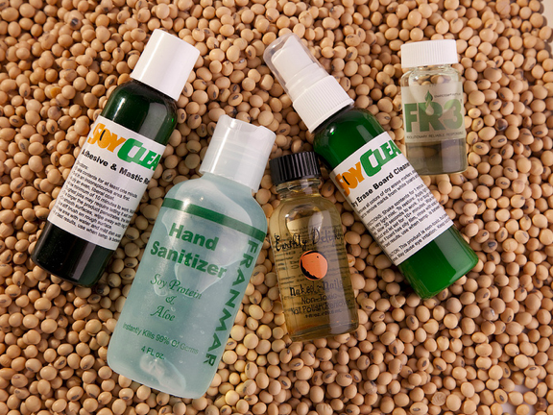
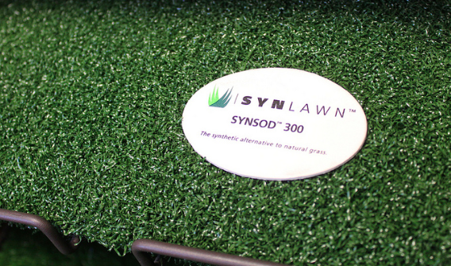
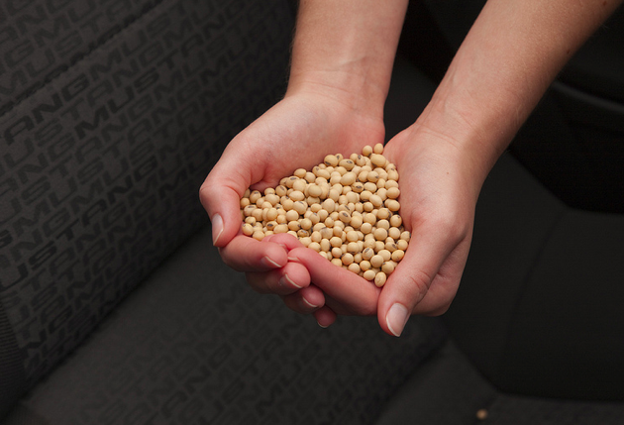
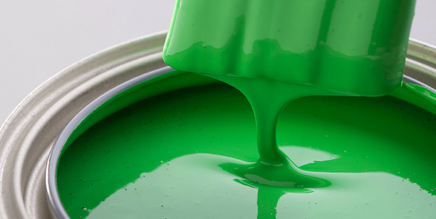
What Do These Have in Common?
Mayonnaise
Biofuel
Foam car seating
Lubricant
Cleaners
Paint
Astroturf
Lip Balm
Cooking Oil
Ink
Infant Formula
Livestock Feed
Fish Food
Salad Dressing
Crayons
Tofu
Candles
Images from the United Soybean Board
Soybeans!
Notes:
https://www.flickr.com/photos/unitedsoybean/10478293344/in/album-72157636940178565/
https://www.flickr.com/photos/unitedsoybean/10478757914/in/album-72157636940178565/
https://www.flickr.com/photos/unitedsoybean/10478814864/in/album-72157636940178565/
https://www.flickr.com/photos/unitedsoybean/10481948313/in/album-72157636940178565/
https://www.flickr.com/photos/unitedsoybean/10481948313/in/album-72157636940178565/
https://www.flickr.com/photos/unitedsoybean/10482512703/in/album-72157636940178565/
https://www.flickr.com/photos/unitedsoybean/10479102635/in/album-72157635284063701/

Slide 12
To Learn More Visit:
Grownextgen.org
Soyohio.org
Unitedsoybean.org

